Slide 1




NETWORK SECURITY LOG ANALYSIS
Submitted to the
MTI Faculty of Engineering
SUPERVISOR: DR /MOHAMMED SHARAF
CO-SUPERVISOR: ENG.ASMAA HEKAL
Reem Ashraf Hashem 89282
Fatma Amr Hussein 89087
Farah Khaled Mohammed 89297
Mariam Wafik William 89824
Rita Sherif Ramzy 89833

Slide 2

INTRODUCTION

Slide 3
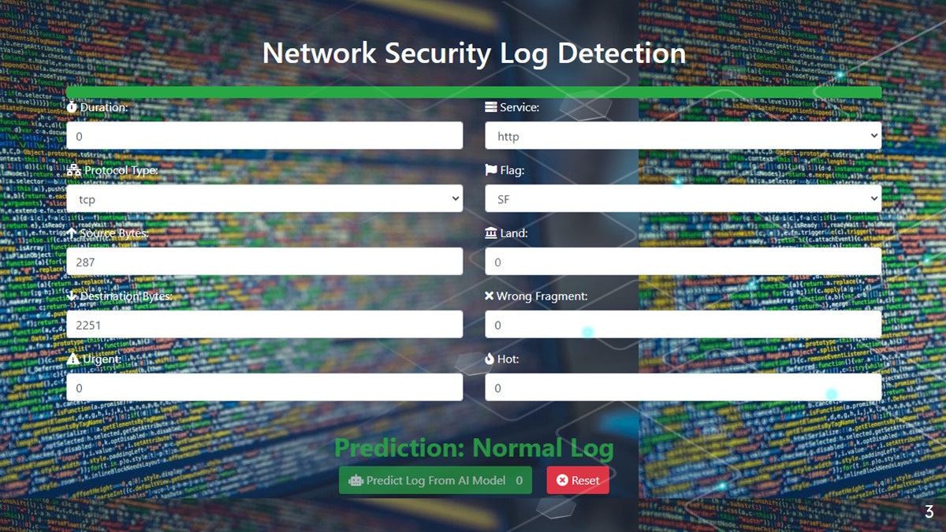

Slide 4


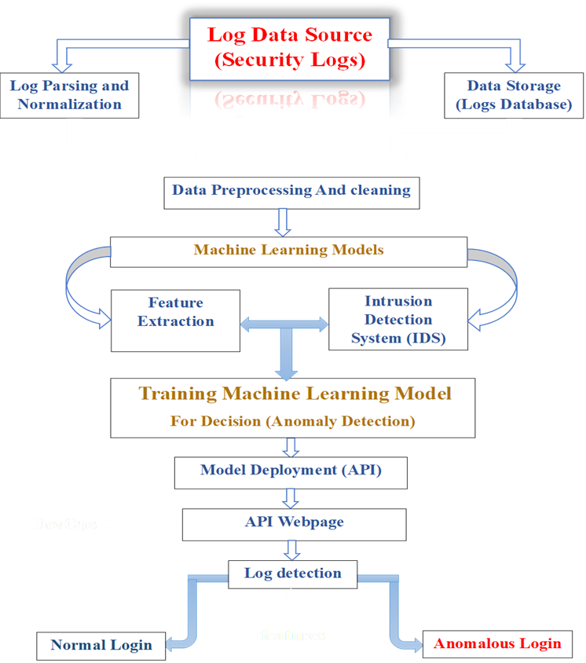
PROJECT DIAGRAM

Slide 5
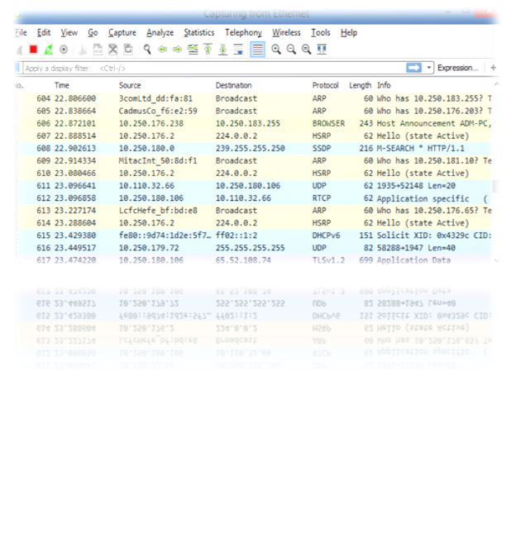
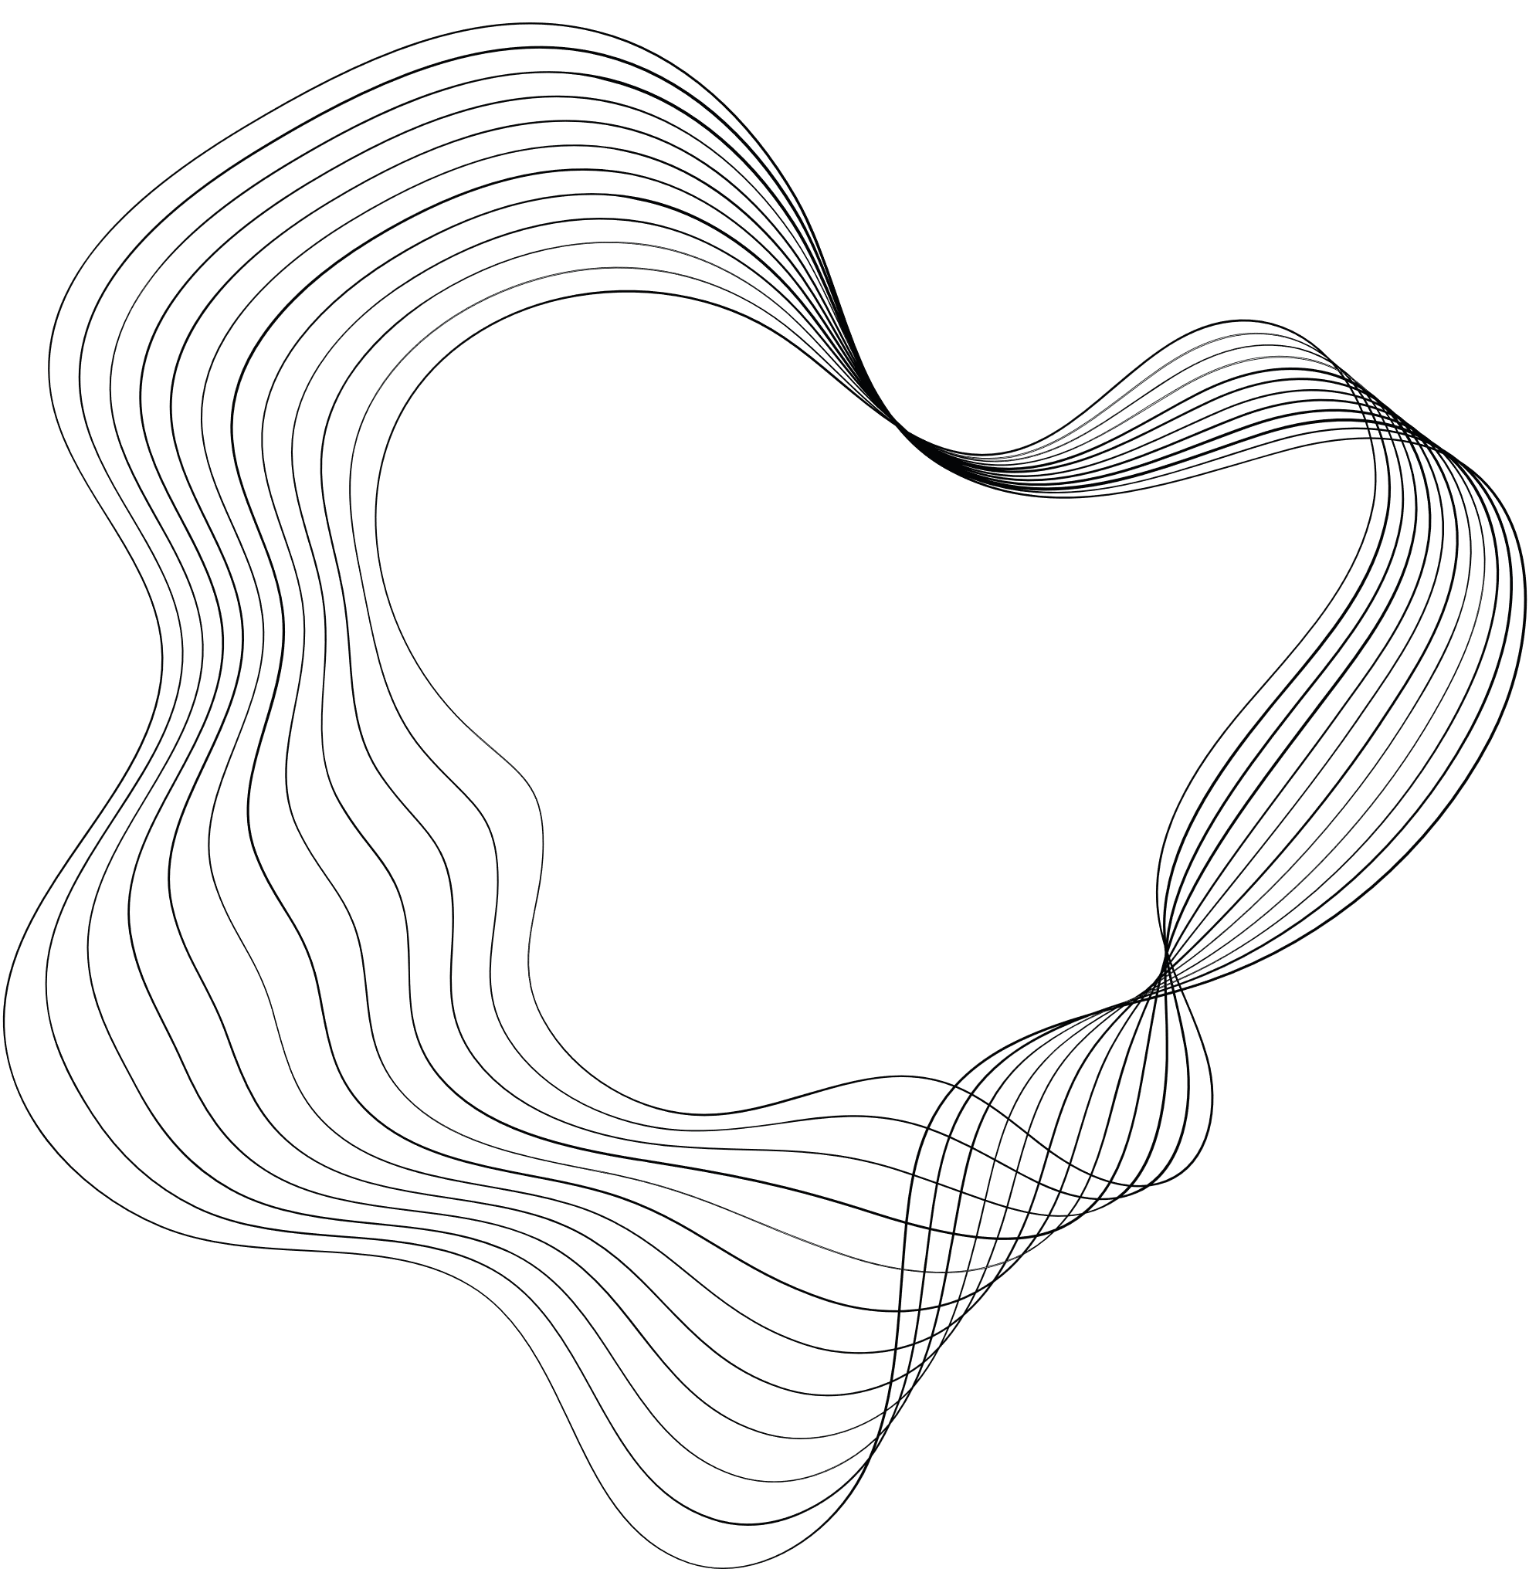
WHAT ARE THE LOG FILES

Slide 6

Log file:
Log files are records generated by software, operating systems, or devices that store events, actions, and messages occurring within a system.
Log files can include details like timestamps, event descriptions, error messages, user activities, system events, and more.
They play a crucial role in tracking system behavior, troubleshooting issues, and monitoring system performance
⬡Log Files Come From Apps, Databases, Firewalls, Endpoints, IoT devices, Networks, Servers and Web Services
⬡
Types of Logs can be Event Logs, Server Logs, System Logs (syslog), Access Logs, and Threat Logs

Slide 7

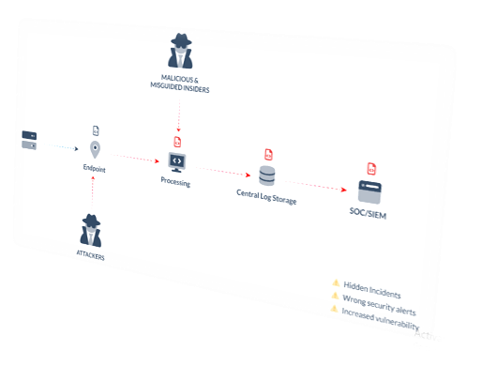


1.
HOW LOG DATA CAN GET TAMPERED WITH

Slide 8
⬡Log Injection: Log injection involves injecting false or malicious log entries into log files. Attackers use this technique to obfuscate their activities
⬡Log Deletion: Log deletion refers to the act of removing or erasing log entries from log files
⬡Log Alteration: Log alteration involves modifying existing log entries to manipulate or misrepresent the information contained within them

Slide 9

The used algorithms for our project
K-Nearest Neighbors (KNN)
•Simplicity
•Effectiveness
•Non-parametric
•Logistic Regression
•Interpretability
•Efficiency
•Binary Classification
•Decision Tree
•Interpretability
•Handling Non-linear Relationships
•Feature Importance

Slide 10
PROJECT DIAGRAM

Slide 11
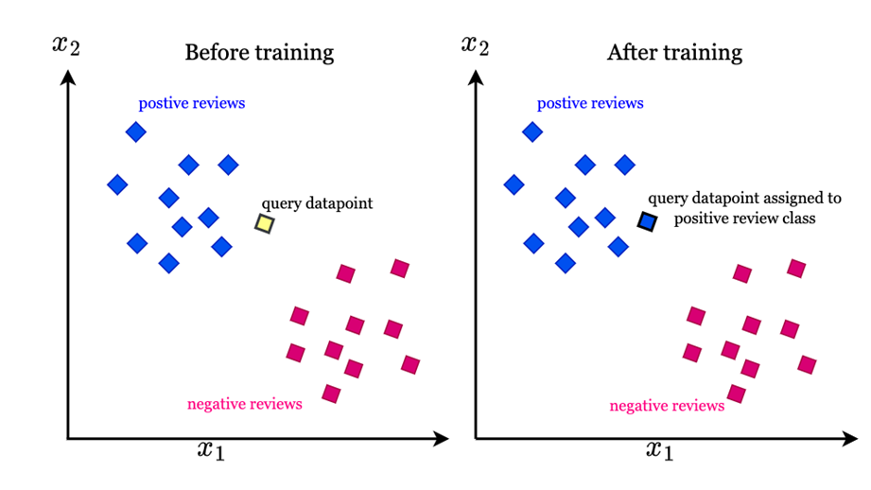
K-Nearest Neighbors (KNN)
KNeighborsClassifier: High precision, recall, and F1-score.
o Very high performance, close to the Decision Tree.

Slide 12
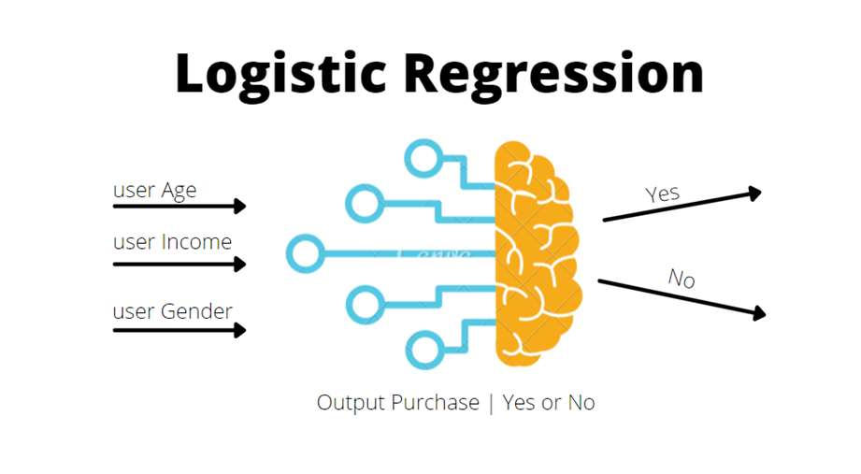
Logistic Regression
Logistic Regression classifier :Good performance, but lower than KNN and Decision Tree.
Good performance, but not as high as the other two models.

Slide 13
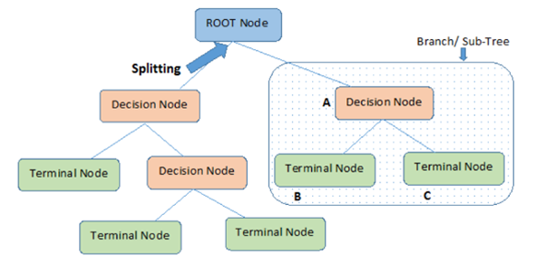
Decision Tree
·Decision Tree classifier : Highest performance with perfect scores, indicating excellent model
·Highest performance with perfect scores

Slide 14
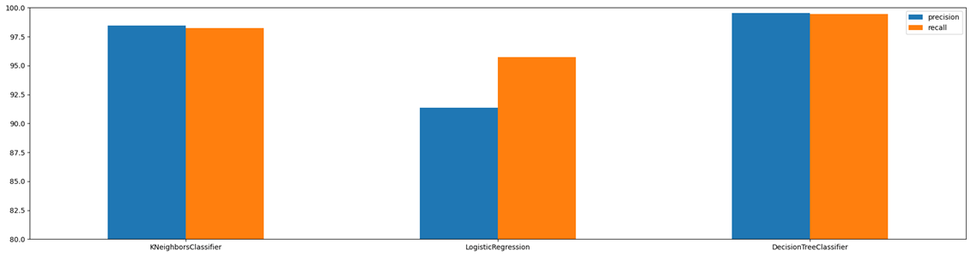
Axes
•Y-Axis (Vertical): Represents the scores in percentage, ranging from 80% to 100%.
•X-Axis (Horizontal): Represents the three different models being compared.
- Bars
•Blue Bars: Represent the precision scores for each model.
•Orange Bars: Represent the recall scores for each model.

Slide 15
SUMMARY
Best Model: DecisionTreeClassifier, as it has the highest precision and recall scores, indicating superior performance.
- Performance Insights:
•The KNeighborsClassifier also performs well, but slightly less than the DecisionTreeClassifier.
•Logistic Regression, while having high recall, has a notably lower precision compared to the other models, indicating a trade-off in its performance.

Slide 16
DISPLAYING PREPROCESSED DATA

Slide 17



Preprocessing data
Print shape of training data
·Check the missing values in each column in the training data .
Check the duplication row in the training data
Load the CSV file of the training and test data

Slide 18
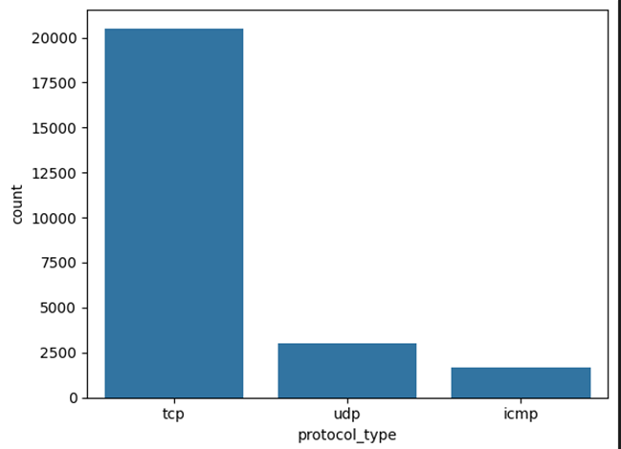
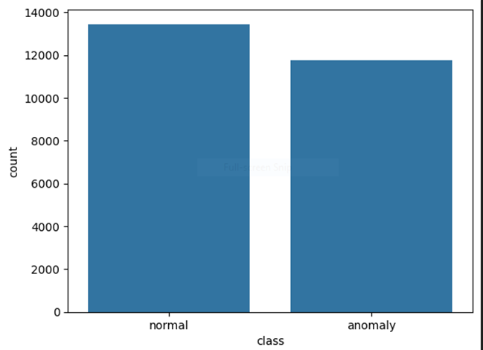
·One graph display the level of each class.
Other graph display the level of each protocol types

Slide 19
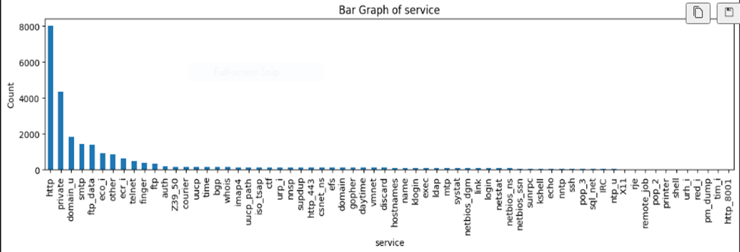
·This graph display the level of each service types.

Slide 20
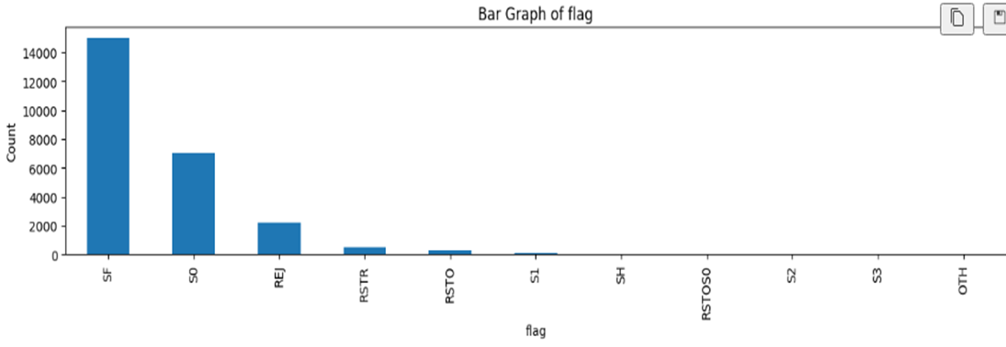
•This graph display the level of each flag types.

Slide 21
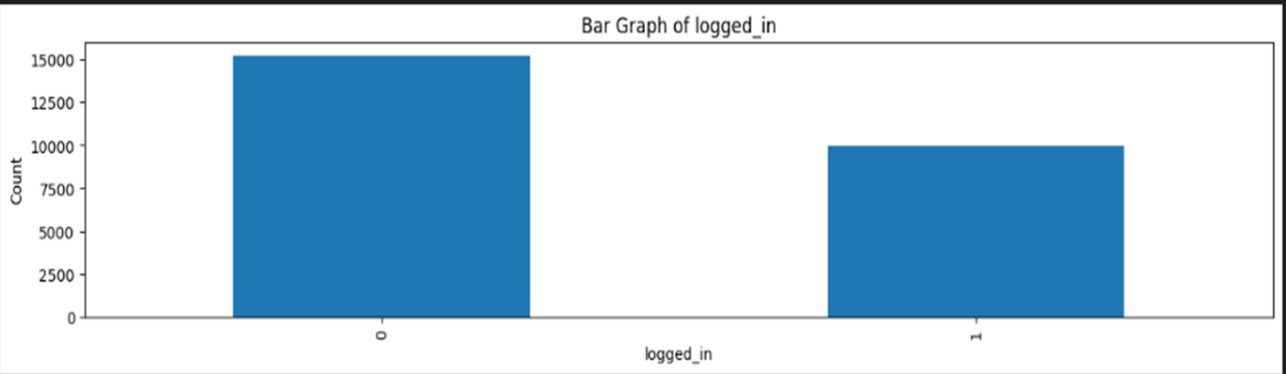

THIS GRAPH DISPLAY THE LEVEL OF EACH LOGGED_IN TYPES

Slide 22
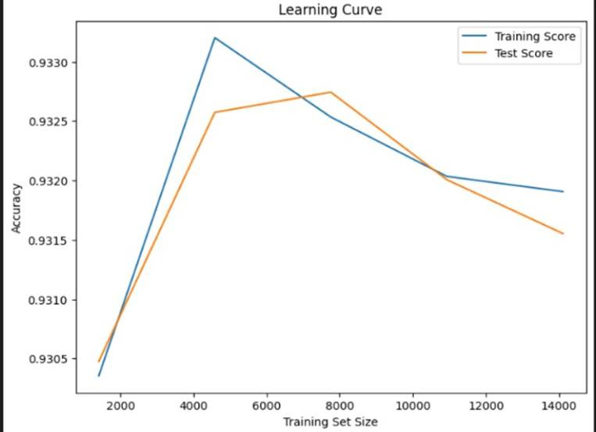
·Training score is the accuracy of training data.
·Test score is the accuracy of test data.
·Train set size is change in each time make iteration for the model.
Remy Marsh

Slide 23
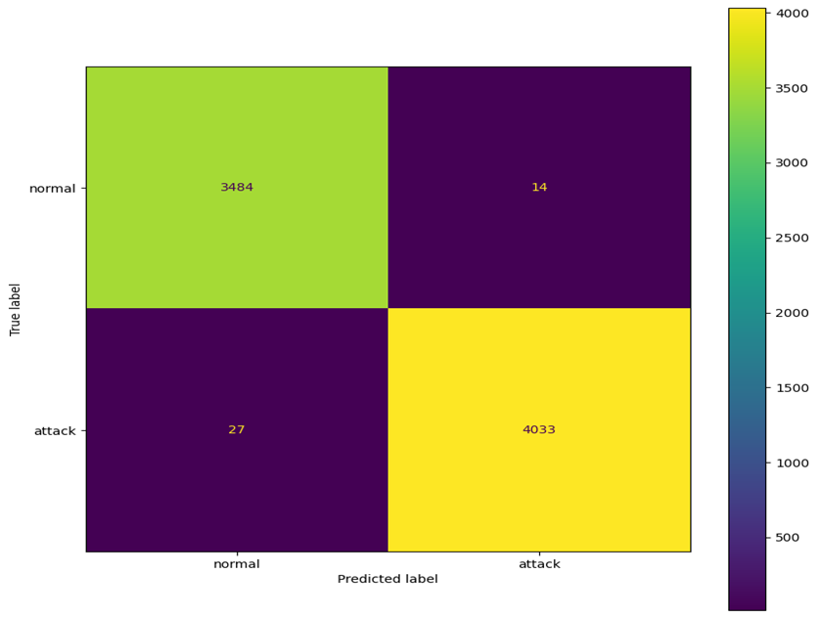
·This confusion matrix for DecisionTree Classifier .
·From confusion matrix can considered
·Accuracy.
·Precision.
·Recall.
·Specificity .

Slide 24
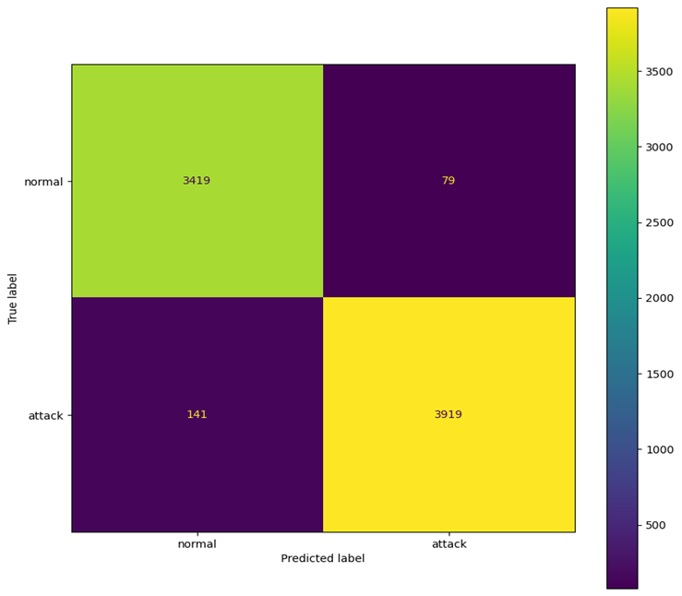

·What is the different between this two confusion matrix?

Slide 25
WEB DEVELOPMENT

Slide 26

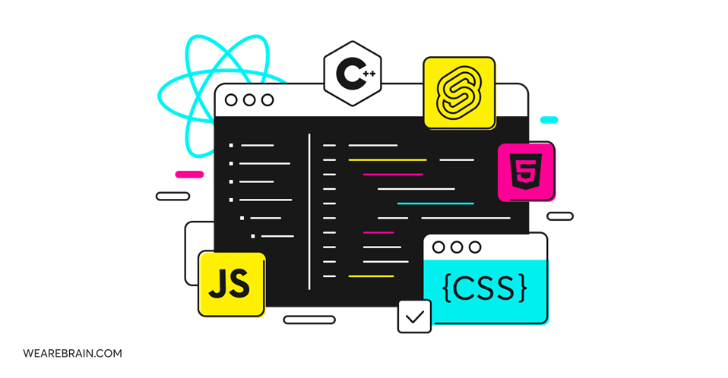
WHAT IS A FRONTEND?
The frontend is the part of the website users directly interact with. This includes the design, text, images, videos, and overall layout.

Slide 27
Anomaly detection webpage

Slide 28

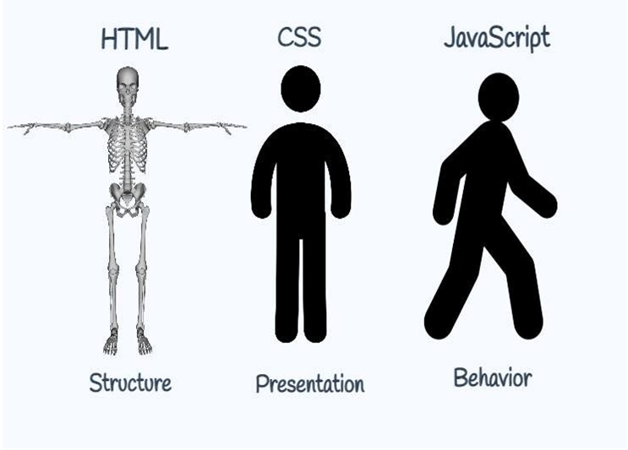
Frontend Languages
⬡HTML(Hypertext Markup Language)
⬡CSS(Cascading Style Sheets)
⬡JAVASCRIPT

Slide 29

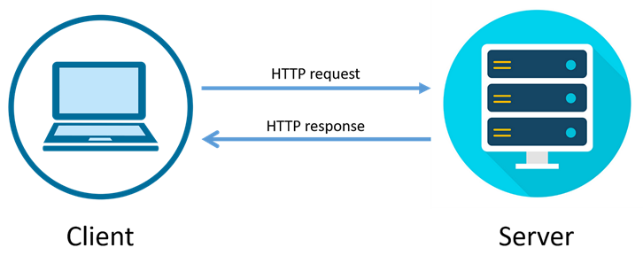
What is a Backend?
Sometimes called the server side , the backend of your application manages your web application's overall functionality.
body text

Slide 30

Backend languages
⬡PHP
⬡PYTHON
⬡Ruby
⬡NODE.JS

Slide 31


Slide 32


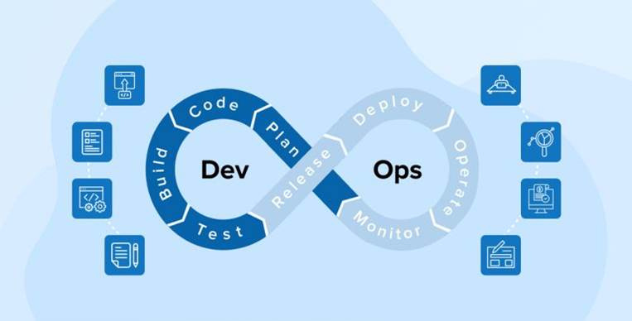
DevOps
The acronym of DevOps is combining two major segments of the software
development process
operation
process

Slide 33





DevOps
Dvelopment
Operations
PLATFORM
GOOGLE
PLATFORM
AWS
MICROSOFT
AZURE

Slide 34
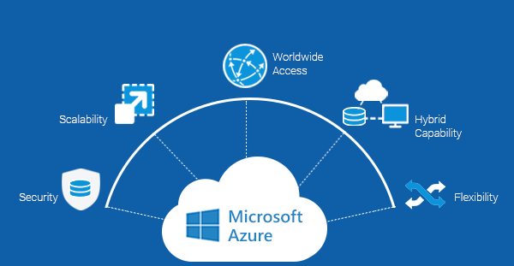
why microsoft azure?
Automated set of processes
that helps developers to build, and deploy codes on platforms
-No manual intervention, all the changes are automatically executed in the project

Slide 35

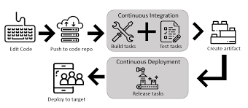
Azure Pipelines

Slide 36

FUTURE PPREDICTIONS TO OUR PROJECT
- increase features used, train , test the model , then we will use the benifits of devOps as we will change in the github code only
- use deep learning instead of machine learning , adding Neural Networks

